Slide 1

Paying For Newsroom Scale
Jim Moroney
April, 2012

Slide 2
Strategy for Success
Differentiated and relevant products:
Local news and information
Sustainable competitive advantage:
The scale of your newsroom
Apply your scale:
Breadth and depth of local reporting

Slide 3
The Dilemma
Is Your Competitive Advantage Sustainable?
Not,
unless we
diversify our sources of revenue

Slide 4



Why Our Industry Should Care
1
3
TV newsrooms win
Promotion platform
Exclusive prime time & sports
2
Two ubiquitous
distribution systems

Slide 5
The problem circa 2008
Q2, 2008 = 10
80/20
80/20
60/40
50/50?

Slide 6
One Solution
Inelasticity of home delivery pricing
Rate x Volume = Total Revenue
Increases in rate mean declines in volume, yet total revenue still goes up
Example: $240 (rate) x 300,000 (volume) = $72,000,000
Raise Rate: $360 (+40%) x 252,000 (-14%) = $84, 672,000 Total revenue increase: +$12.6M or +18%
Total Revenue Increase: +$12.6M or +18%

Slide 7
Results
2007
2011
Advertising 78%
Advertising 54%
Circulation 18%
Circulation 39%
Production & Distribution 4%
Production & Distribution 7%
$125 Million

Slide 8



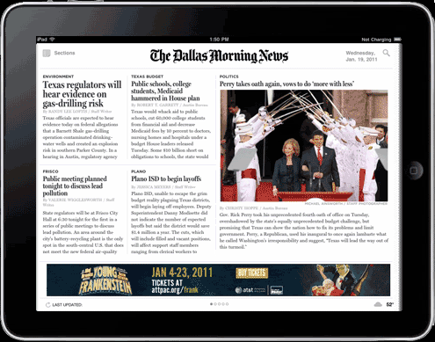
Next Logical step: Gated Premium Content
Our Approach:
Web site and apps available for free
Wires and commodity news is free with unlimited access
Differentiated, relevant local news and information requires subscription

Slide 9
Results to date
PV's and UV's decline by -35%
Authenticated 40% of print subs in first year
Digital only subscriptions continue to grow, but modest
70% of new print subs as of October, 2011 opt in to pay for digital access
iPad replica edition sessions average 28 minutes

Slide 10
Parting Thoughts
Print ad revenue decline is secular and permanent
Digital advertising provides revenue growth but insufficient to support present scale
Diversify sources of revenue and decrease dependency on print advertising
Home delivery pricing is a good place to start
Consider offering marketing services, especially digital/social
Two-thirds of marketing spending in the US is not advertising: it's "below the line"

