Slide 1
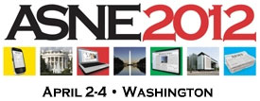
Things your newsroom should do right now

Slide 2
EXPERIMENT

Slide 3
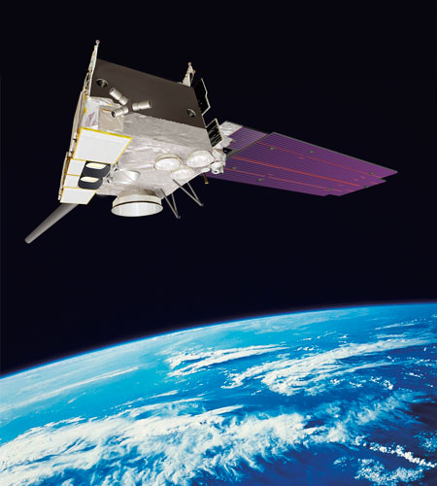
Geostationary Satellites
Arthur C. Clarke, Wireless World, Oct. 1945

Slide 4
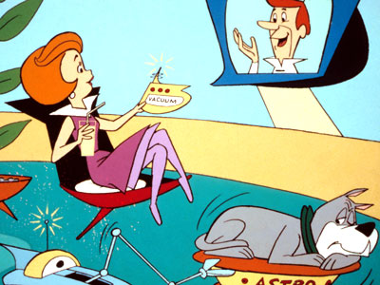
Skype
The Jetsons, 1962

Slide 5
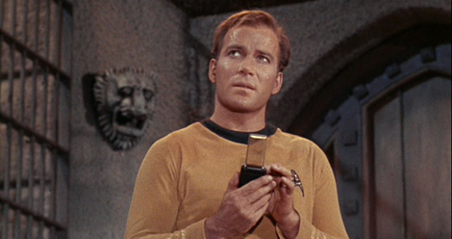
Cell Phones
Star Trek, 1964

Slide 6
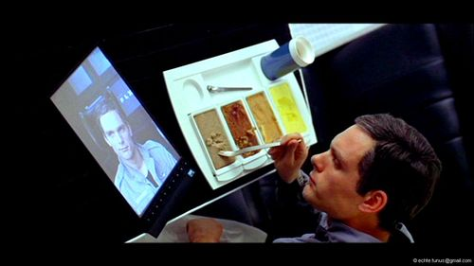
The iPad
2001: A Space Odyssey, 1968

Slide 7
Things your newsroom should do from now on

Slide 8
EXPERIMENT
… OPENLY

Slide 9
Things your newsroom should do right now…
www.NiemanLab.org/ASNE
www.KnightApps.org

