Slide 1


Armitage and Metasploit Penetration Testing Lab
Raphael Mudge
rsmudge@gmail.com
Twitter: @armitagehacker

Slide 2
Penetration Testing
Armitage and Metasploit Penetration Testing Lab

Slide 3
Overview
Personal Introduction
Penetration Testing
Process
Course Overview

Slide 4
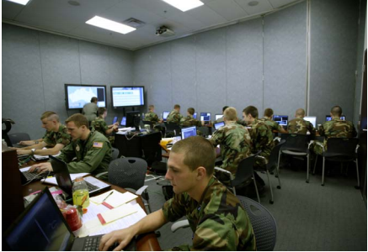

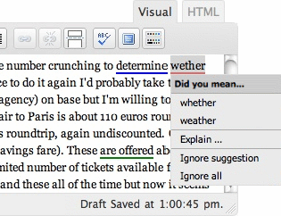
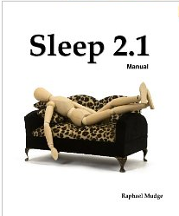
Introduction – R. Mudge
Previous Experiences
  Penetration Tester
  Regional CCDC Red Team x 5
  USAF Security Researcher
  Armitage for Metasploit
Other Experiences
  WordPress Grammar Checker
  Programming Language

Slide 5
Penetration Testing
What? Test security by doing what bad guys might do

Slide 6
Penetration Testing
Why? Motivate desire to make changes to improve security

Slide 7
Penetration Testing
How? Demonstrate risk

Slide 8
Types of Penetration Tests
Open Source Research
Network
Social Engineering
Wireless
Web Applications
Mobile

Slide 9
Penetration Testing Process
Information Gathering
Reconnaissance
Access
Post-Exploitation

Slide 10
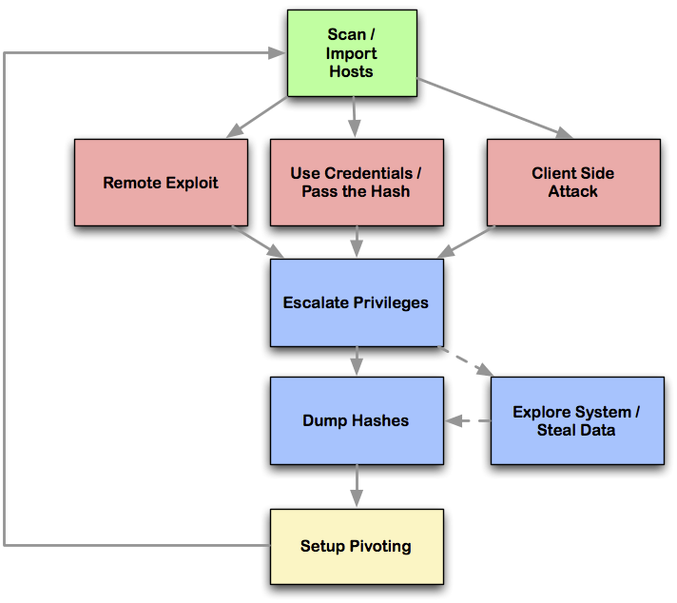
Network Attack Process

Slide 11
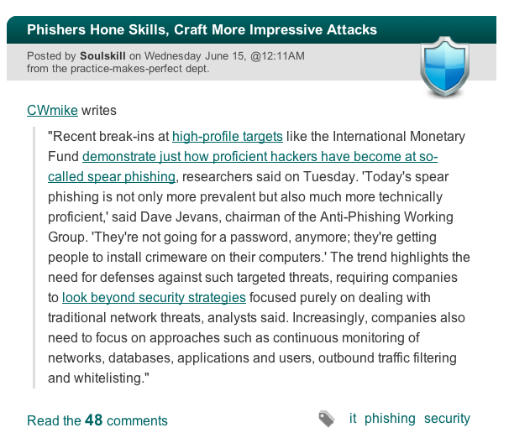
Motivation

Slide 12
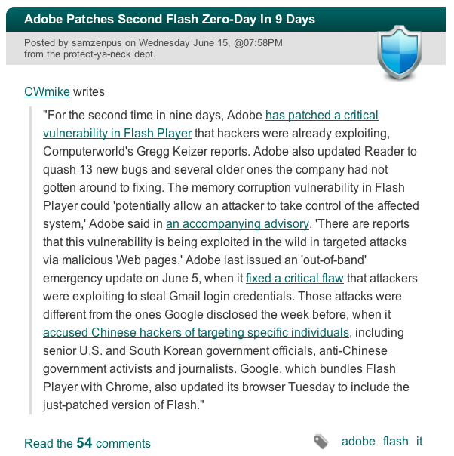
Motivation

Slide 13
Course overview
Penetration Testing
Metasploit
Getting Access
Post Exploitation
Maneuver

Slide 14
Goals
Install Metasploit
Get Access to Hosts
Post-exploitation

Slide 15
Learning Check
Who is Raphael Mudge?
Why Penetration Test?
What are we doing today?

Slide 16
Metasploit
Armitage and Metasploit Penetration Testing Lab

Slide 17
Overview
What is Metasploit?
Modules
Metasploit Console
Armitage

Slide 18
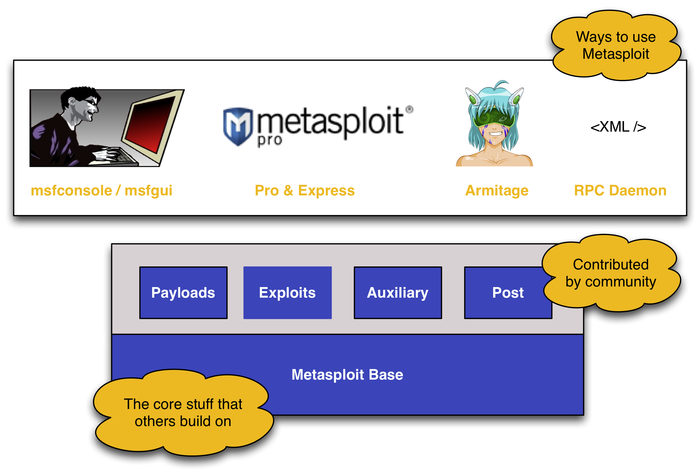
What is Metasploit?

Slide 19
What is Metasploit?
Metasploit Linux
Modules Programs
msfconsole /bin/bash
RPC Daemon sshd

Slide 20
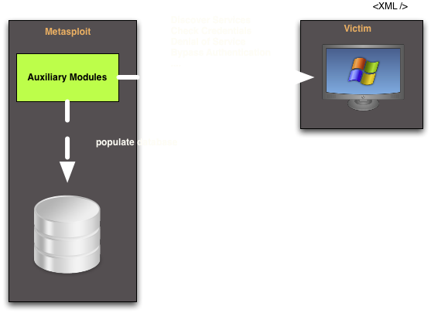
Modules

Slide 21
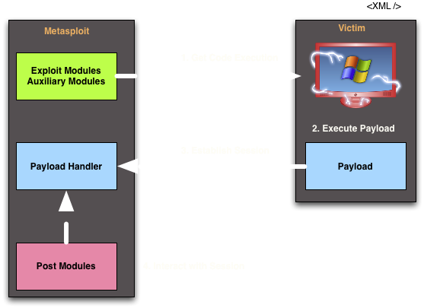
Modules

Slide 22
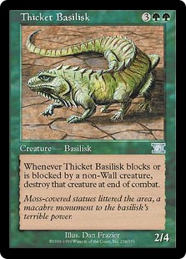
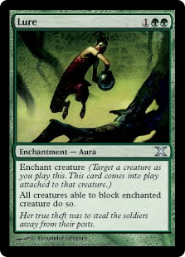
Modules and Magic the Gathering
© 1995-2011 Wizards of the Coast
Notes:
Examples:
1) Use auxiliary module to enumerate SMB and find out domain info; Use hashdump post module to gather credentials; Use psexec module to get code execution
2) Use snmp module to brute force community string; Use cisco_download_config to download router config file

Slide 23
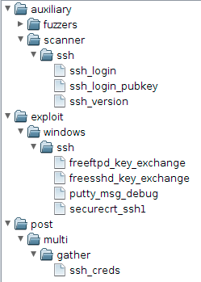
Module Organization

Slide 24
Metasploit Command Sets
Metasploit Console
  Manage Database
  Manage Sessions
  Configure and Launch Modules
Meterpreter
  Post-exploitation activities

Slide 25
Console Cheat Sheet
use module - start configuring module
show options - show configurable options
set varname value - set option
exploit - launch exploit module
run - launch non-exploit
sessions –i n - interact with a session
help command - get help for a command

Slide 26
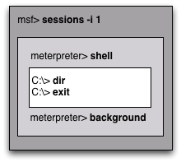
msfconsole
Open ended
Works in many places
One task / host at a time

Slide 27
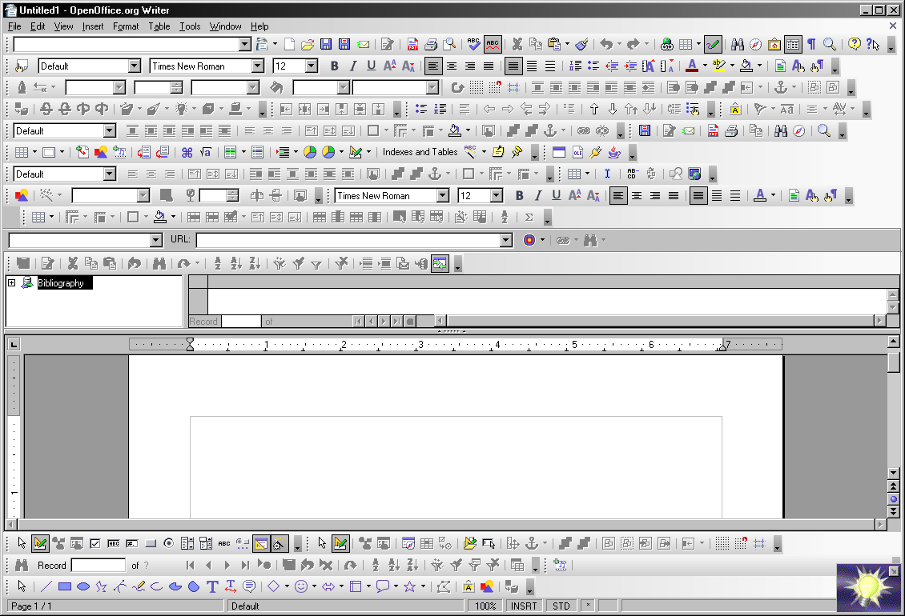
What is Armitage?
A GUI for Metasploit
Goal: Avoid this…

Slide 28
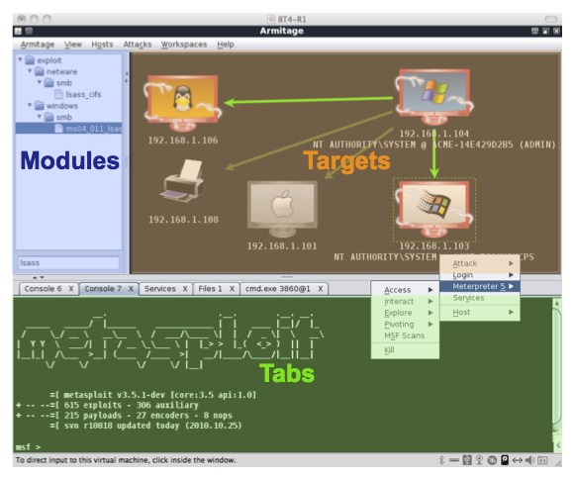
Armitage

Slide 29

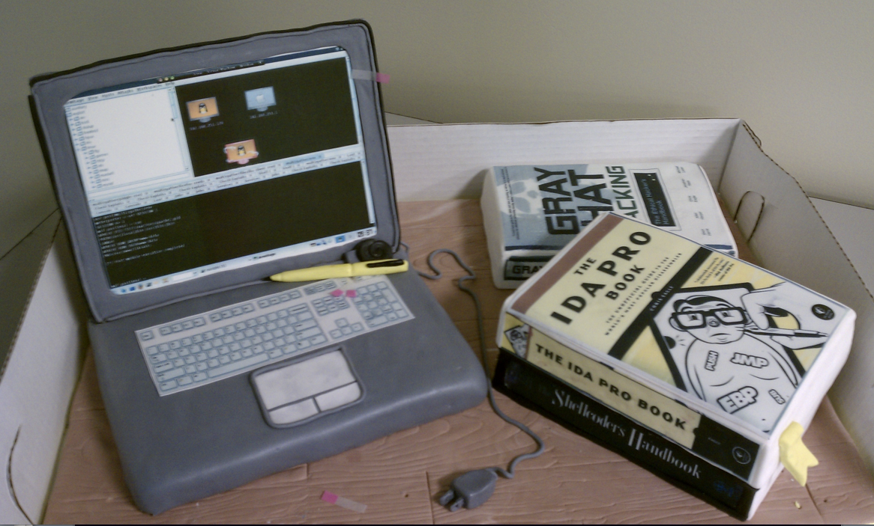

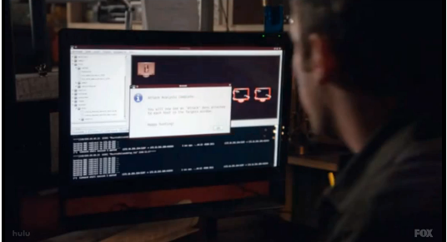

Armitage Sightings…

Slide 30
Console Demo

Slide 31
Learning Check
What is a session?
What is a payload?
What do exploits do?

Slide 32
Getting Access
Armitage and Metasploit Penetration Testing Lab

Slide 33
Overview
Remote Exploits
Exploit-free Attack
Client-side Exploits

Slide 34
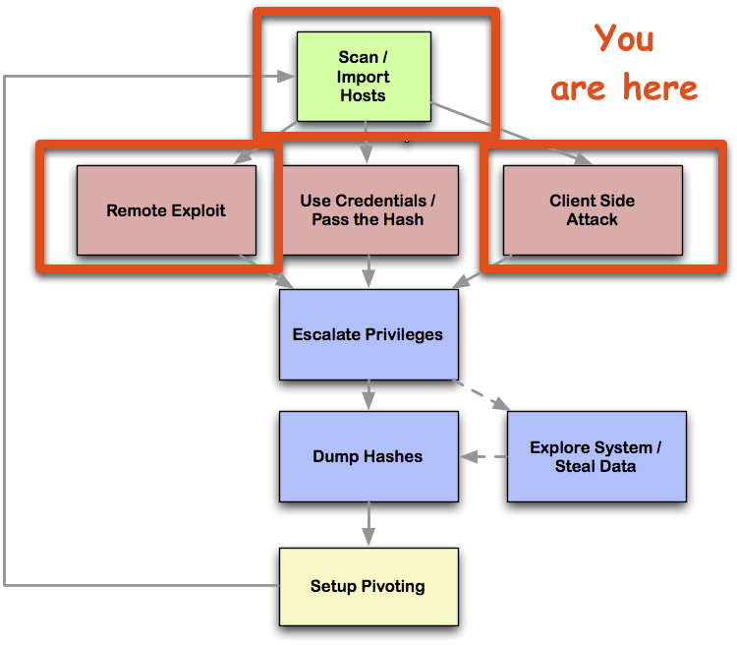
Network Attack Process

Slide 35
Remote Attack
NMap Scan
Analyze Scan Data
Choose an Exploit
Select a Payload
Launch Exploit!

Slide 36
Which exploit do I use?
Answer: These.
Name | Where
ms08_067_netapi | Windows XP/2003 era
ms09_050_smb2_negot.. | Windows Vista SP1/SP2
ms03_026_dcom | Windows 2000

Slide 37
Why did my exploit fail?
Firewall
Non-vulnerable software
Service is hung
The universe is taunting you
Non-reliable exploit
Bad day
Mis-configured exploit
Could not establish session

Slide 38
Exploit-free Attack
Choose a payload
Generate executable
Set up a multi/handler

Slide 39
Payloads
Name | Note
windows/meterpreter/reverse_tcp | Connects to one port
windows/meterpreter/reverse_tcp_allports | Tries every ports in sequence
windows/meterpreter/reverse_https | Speaks HTTPS (!!!!)
java/meterpreter/reverse_tcp | Any platform with Java
linux/x86//shell_reverse_tcp
osx/x86/shell_reverse_tcp

Slide 40
Client-side Attack
Fingerprint sample of victims
Choose an Exploit
Launch Expoit
Spam victims (or wait for them)!

Slide 41
Which exploit do I use?
Answer: These.
Name | Where
java_signed_applet | Social engineering; any where Java applets run
ms11_003_ie_css_import | Internet Explorer 7/8 (requires .NET)
ie_createobject | Internet Explorer 6

Slide 42
Learning Check
Which module listens for a connection from a payload?
Which exploit works against Windows XP SP2, port 445?

Slide 43
Post-Exploitation
Armitage and Metasploit Penetration Testing Lab

Slide 44
Overview
Command Shell
Privilege Escalation
Spying on the User
File Management
Process Management
Post Modules and Loot

Slide 45
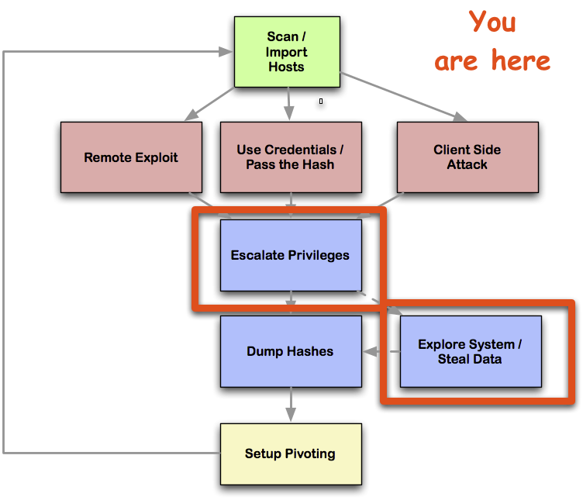
Network Attack Process

Slide 46
Demo Demo Demo

Slide 47
Learning Check
Which Meterpreter command takes a screenshot?
Which Meterpreter command is most useful to you?

Slide 48
Maneuver
Armitage and Metasploit Penetration Testing Lab

Slide 49
Overview
Pivoting
Scanning
Attacking

Slide 50
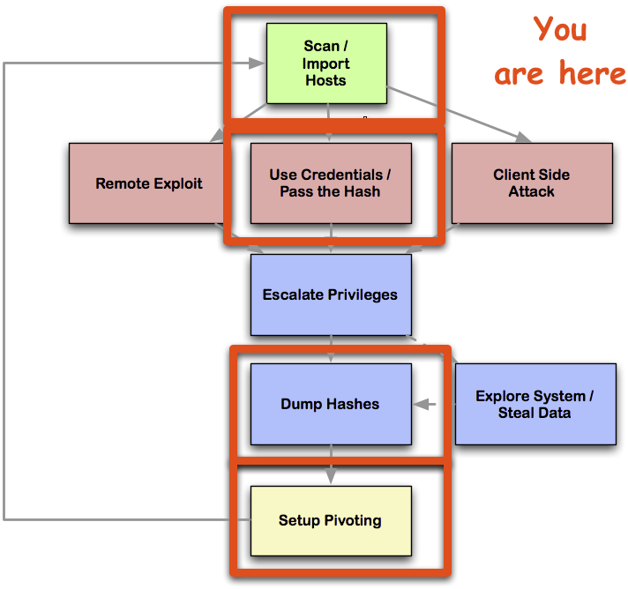
Network Attack Process

Slide 51
Demo Demo Demo

Slide 52
Learning Check
Which module gives a session on a Windows host using credentials or hashes?
Which scan should you do before setting up a pivot?

Slide 53
Network Attack Process

Slide 54
Resources
Armitage and Metasploit Penetration Testing Lab

Slide 55
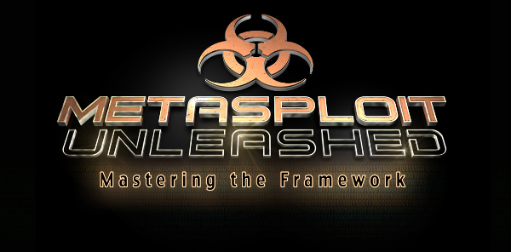
Free Metasploit Course
http://www.offensive-security.com/metasploit-unleashed

Slide 56
Metasploit Homepage
http://www.metasploit.com

Slide 57
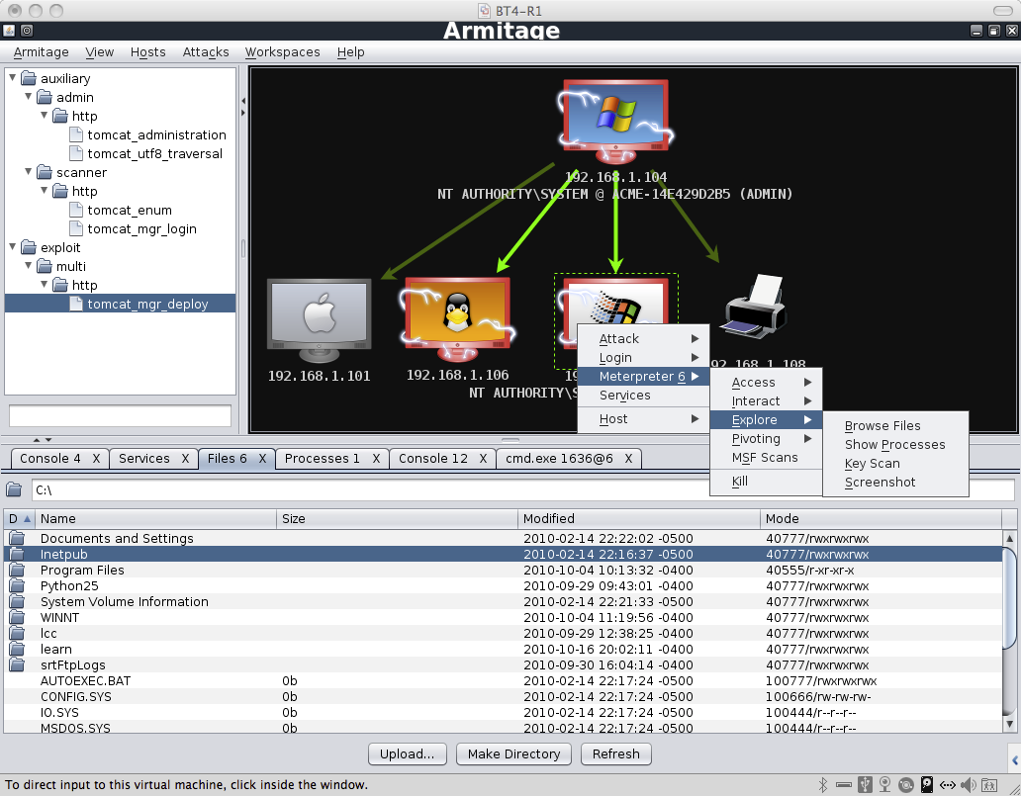
Armitage Homepage
http://www.fastandeasyhacking.com

Slide 58

BackTrack Linux
http://www.backtrack-linux.org/

Slide 59
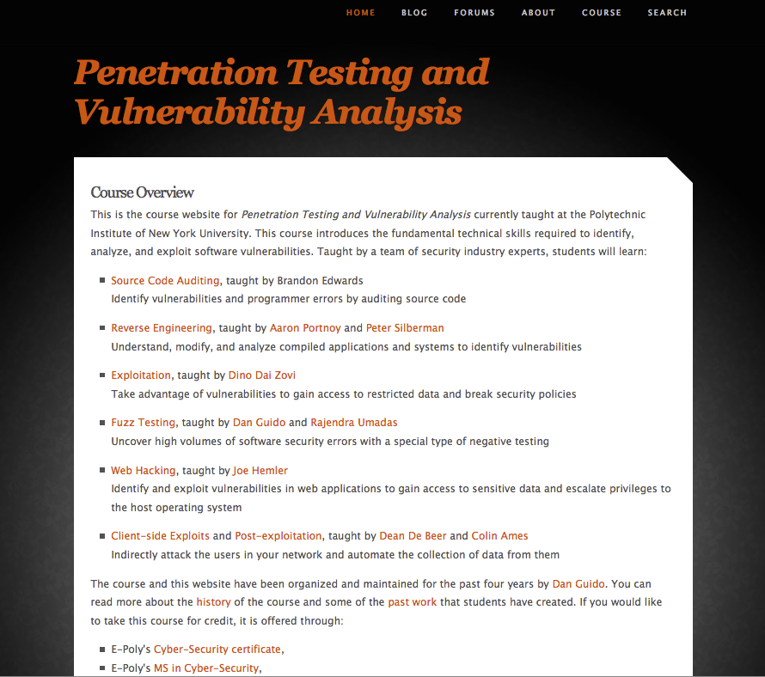
Pen Test & Vuln Analysis Course @ NYU
http://pentest.cryptocity.net

Slide 60
Armitage and Metasploit Penetration Testing Lab
Raphael Mudge
rsmudge@gmail.com
Twitter: @armitagehacker

